Slide 1
Predicting customer buying behaviour
By Christian De Los Santos

Slide 2
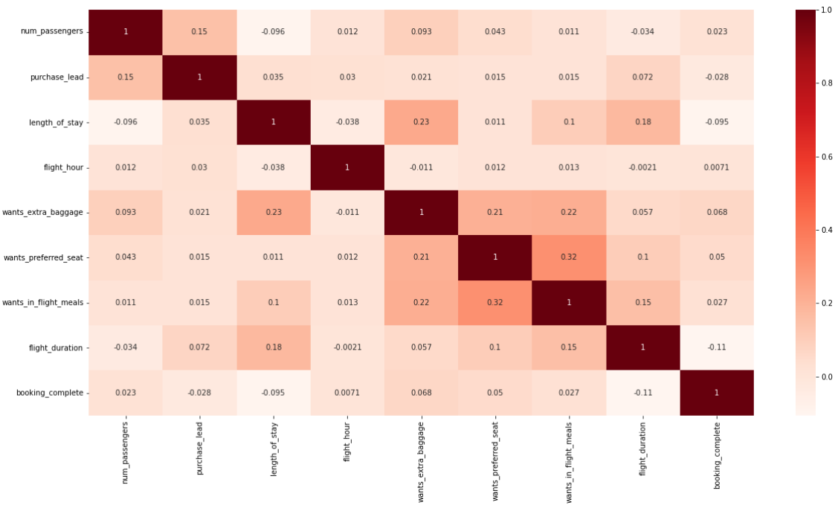
Correlation heatmap

Slide 3
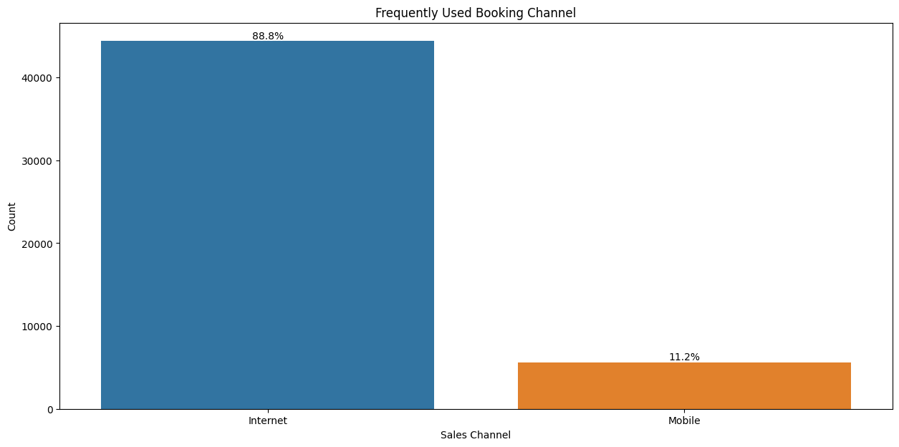
Frequently Used Booking Channel

Slide 4
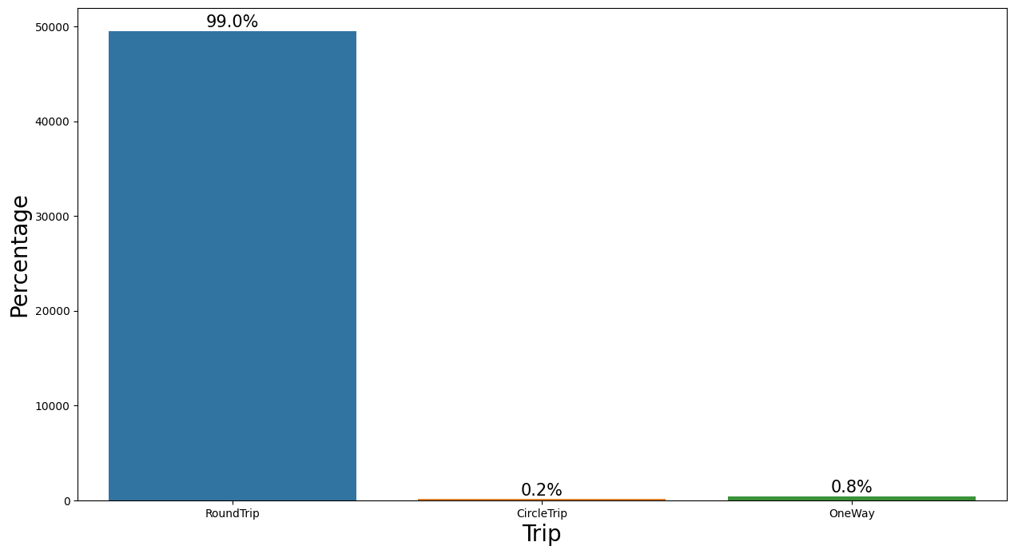
Percentage of Trip

Slide 5
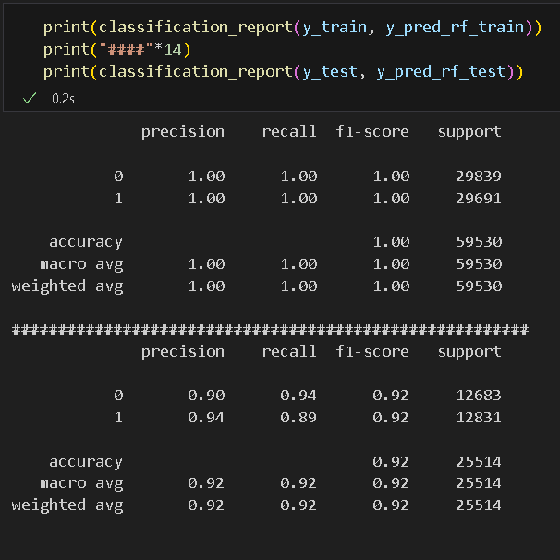
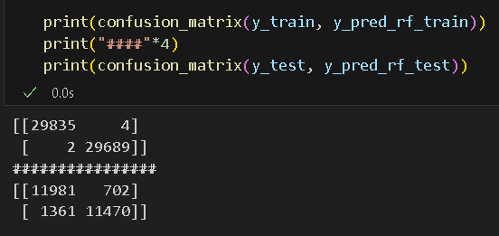
Evaluate Model Performance

Slide 6
Thank you

